Slide 1

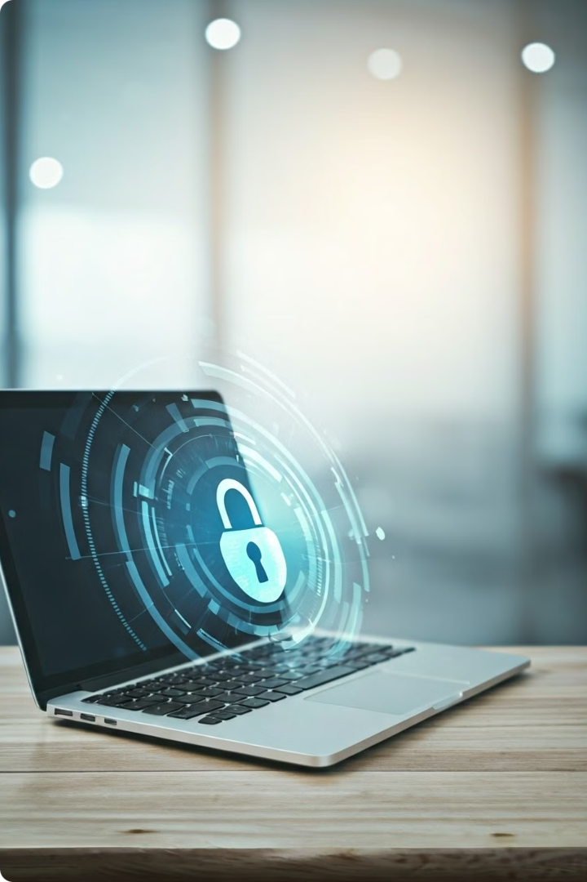
Introduction to Multi-Factor Authentication (MFA)
Multi-Factor Authentication (MFA) is a security measure that adds an extra layer of protection to your online accounts. It requires you to provide two or more pieces of evidence to verify your identity before granting access. This could include a password, a one-time code sent to your phone, or a biometric factor like your fingerprint or face. MFA helps prevent unauthorized access to your accounts, even if your password is compromised.

Slide 2
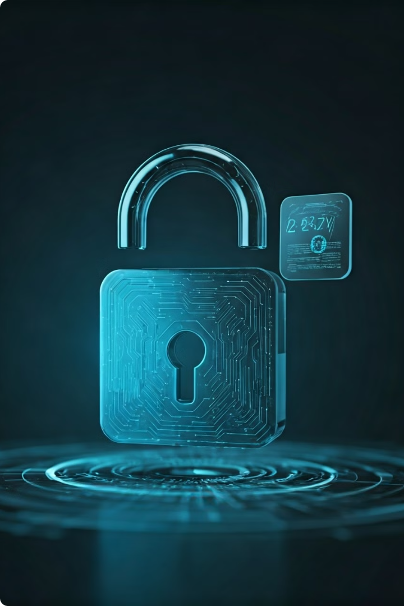
Importance of MFA for Cybersecurity
1
Enhanced Security
MFA significantly reduces the risk of account breaches, as attackers would need to obtain multiple pieces of evidence to gain access. This makes it much harder for them to compromise your accounts.
2
Protecting Sensitive Information
MFA is especially important for accounts that contain sensitive personal or financial information, such as banking, email, and social media. It helps ensure that only you can access this critical data.
3
Compliance and Regulations
Many industries and organizations have regulations that require the use of MFA to protect customer data and maintain security standards. Implementing MFA can help you stay compliant and avoid legal and financial penalties.

Slide 3
Enabling MFA on Your Accounts
Check for MFA Options
Choose Your MFA Method
Set Up MFA
Log in to your online accounts and look for settings or security options that allow you to enable MFA. This is typically found in the account settings or security section.
Depending on the account, you may have the option to use SMS, authenticator apps, or hardware security keys. Consider the level of security and convenience that each method offers.
Follow the instructions provided by the account to set up your chosen MFA method. This may involve entering a phone number, scanning a QR code, or registering a security key.

Slide 4
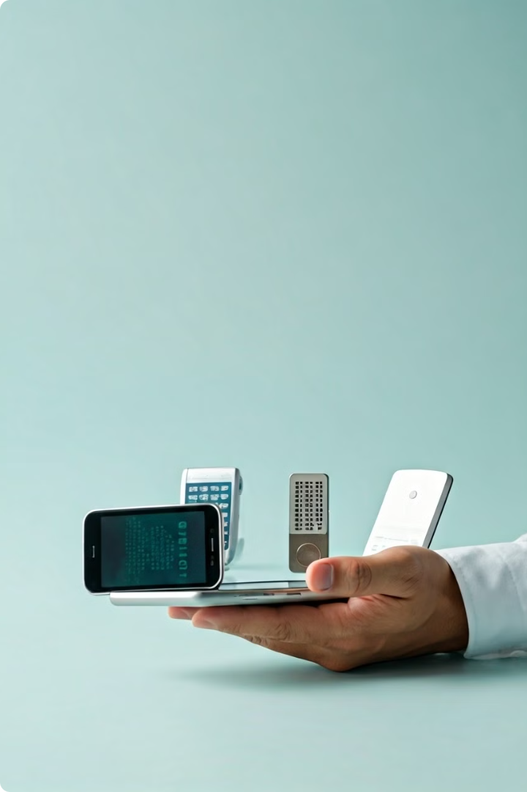
Choosing the Right MFA Method
1
SMS-Based MFA
This method sends a one-time code to your registered mobile number. It's a simple and convenient option, but may be less secure than other methods.
2
Authenticator App-Based MFA
Authenticator apps generate one-time codes on your mobile device, providing a more secure alternative to SMS-based MFA. They don't rely on phone networks and are less susceptible to interception.
3
Hardware Security Key-Based MFA
Hardware security keys offer the highest level of security, as they require a physical device to be present for authentication. They're ideal for high-risk accounts or when you need the strongest possible protection.

Slide 5
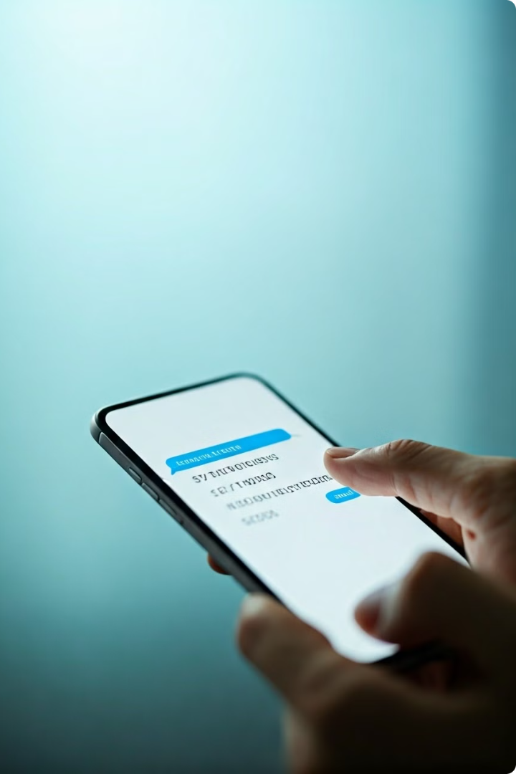
Setting Up SMS-Based MFA
Add Your Phone Number
When setting up SMS-based MFA, you'll need to provide your mobile phone number. Make sure it's a number that you have direct access to and can receive text messages on.
Verify the Code
After entering your phone number, the account will send a one-time code via text message. You'll need to enter this code to complete the MFA setup process.
Keep Your Phone Secure
Since SMS-based MFA relies on your mobile device, it's important to keep your phone secure and protect it from loss or theft. Consider using a PIN, pattern, or biometric lock to prevent unauthorized access.
Backup Options
In case you lose access to your phone, many accounts offer backup options like printable codes or the ability to set up a secondary phone number for MFA.

Slide 6
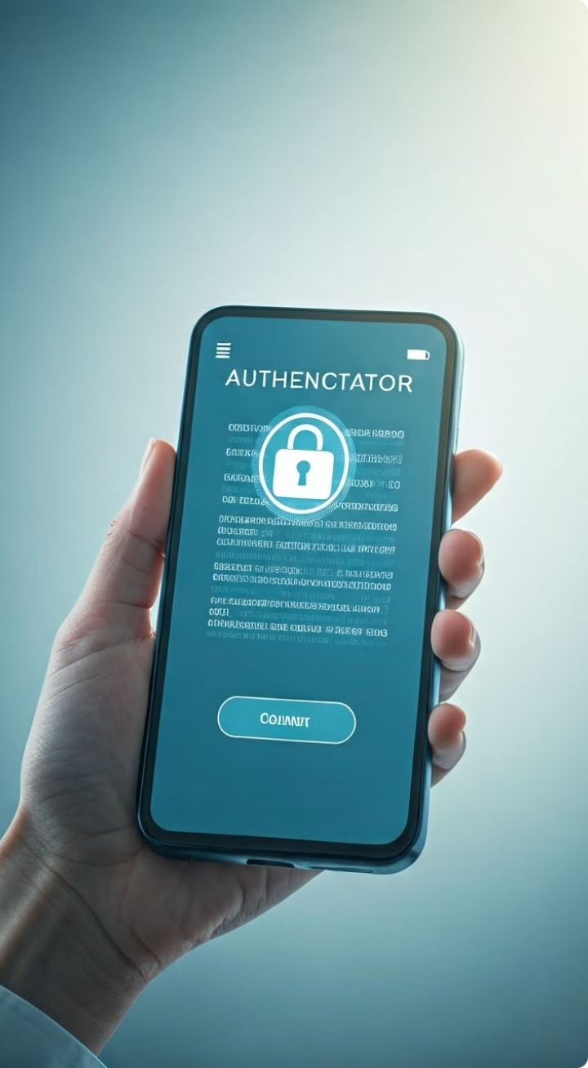




Setting Up Authenticator App-Based MFA
Download Authenticator App
Start by downloading a reputable authenticator app, such as Google Authenticator, Microsoft Authenticator, or Authy, on your mobile device.
Scan the QR Code
When setting up MFA in your account, you'll be prompted to scan a QR code using your authenticator app. This links the app to your account.
Enter the Code
The authenticator app will generate a unique one-time code that you'll need to enter to complete the MFA setup process.
Backup Your Codes
Many authenticator apps allow you to download or print backup codes in case you lose access to your device. Make sure to store these codes securely.

Slide 7




Setting Up Hardware Security Key-Based MFA
Purchase a Security Key
Register the Key
Verify with the Key
Obtain a hardware security key, such as a YubiKey or a Google Titan Security Key, from a reputable manufacturer.
During the MFA setup process, you'll be prompted to connect and register your security key with the account.
After registering, you'll need to use the security key to authenticate your identity whenever you log in to the account.

Slide 8

Managing MFA Devices and Backup Codes
Manage Devices
Most accounts allow you to view and manage the devices associated with your MFA setup. This includes the ability to add, remove, or update devices as needed.
Backup Codes
Many MFA setups provide backup codes that you can use to access your account if you lose your primary authentication device. Store these codes securely, as they can be used to bypass MFA.
Update Settings
Regularly review and update your MFA settings to ensure they're up-to-date and aligned with your current needs and security best practices.
Prepare for Emergencies
Have a plan in place for emergency situations, such as a lost or stolen device, to ensure you can still access your accounts without disruption.

Slide 9
Best Practices for MFA Usage
Use MFA Consistently
Avoid SMS-Based MFA
Keep Your Devices Secure
Enable MFA on all of your important accounts, not just a few. Consistency is key to maintaining a high level of security across your digital life.
Whenever possible, opt for more secure MFA methods like authenticator apps or hardware security keys, as SMS-based MFA is more vulnerable to attacks.
Protect your MFA-enabled devices, such as smartphones and security keys, with strong passwords, biometric locks, and physical security measures to prevent unauthorized access.

Slide 10

Conclusion and Next Steps
Embrace MFA
Implementing MFA is a critical step in protecting your online accounts and securing your digital identity. By taking the time to set up and manage MFA, you're significantly reducing the risk of unauthorized access and safeguarding your sensitive information.
Stay Vigilant
Regularly review your MFA settings, update your devices, and be aware of the latest security threats. Staying proactive and informed will help you maintain the highest level of protection for your accounts.
Encourage Others
Spread the word about the importance of MFA and encourage your family, friends, and colleagues to set it up on their own accounts. Together, we can create a more secure online environment for everyone.

